Slide 1
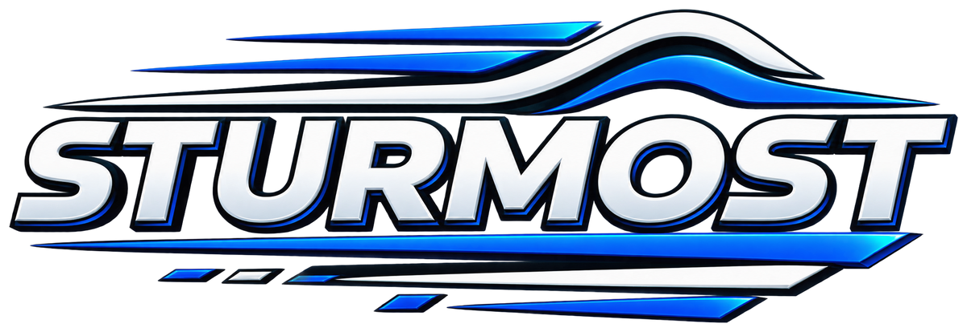
STURMOST
Building products that move money, connect people, and help businesses grow.
A general investor and strategic partner proposal
Investor / incubator affiliations: NONE
Seeking strategic technology access, creative partnership, and growth capital.
October 2026
STURMOST TECHNOLOGIES LTD · London + Nairobi · Investor & partner deck
01

Slide 2
COMPANY THESIS
STURMOST turns technical capability into everyday products.
Our portfolio is built for real usage, not technology demos.
London + Nairobi
A global technology company with operations across software, fintech, mobile, AI, cloud, and security.
Mission
Democratize access to technology and financial services.
The opportunity is to make every product easier to understand, trust, and adopt.
Company-reported scale
50M+
150+
500+
99.9%
active users
countries
team members
uptime
STURMOST TECHNOLOGIES LTD · London + Nairobi · Investor & partner deck
02

Slide 3


PORTFOLIO
A connected portfolio creates more surfaces for growth.
Each product solves a different problem while sharing STURMOST engineering, trust, and distribution.
Brytoq
STURPAY
RudiSoko
Lets Wed
Business opportunity platform
M-Pesa-connected wallet
Dating and social discovery
Intentional relationship matching
PDFSTUR
PlayBust
Cloud Companion
Mobile document workflow
Private local music player
Voice, chat, and paid companionship
STURMOST TECHNOLOGIES LTD · London + Nairobi · Investor & partner deck
03

Slide 4
FLAGSHIP PLATFORM
Brytoq makes opportunity discoverable and actionable.
Founders, investors, employers, and job seekers move through one trusted business ecosystem.
Project publishing and video pitches
Investor discovery and direct in-app chat
Business and idea marketplace
Full-sale or 50% partnership paths
Jobs, reviewer work, AI training, and service credits
Publish → pitch → discover → chat → fund, hire, or acquire.
BVC, moderation, trust, and safety controls
Partner opportunity: accelerate discovery, trust, and job workflows across the platform.
STURMOST TECHNOLOGIES LTD · London + Nairobi · Investor & partner deck
04

Slide 5
CONSUMER AND FINANCIAL PRODUCTS
STURMOST meets people where trust matters most.
Payments, relationships, documents, entertainment, and companionship each need a different communication style.
STURPAY
Send, receive, deposit, withdraw, pay codes, transaction history, KYC, PIN, and biometric protection.
One intelligence layer, many trust contexts
Strategic partners can help STURMOST add intelligence to payments, relationships, documents, and companionship while keeping human oversight.
RudiSoko
Location-aware matching, group dating, gifts, chat, premium access, and dating-advisor work.
Lets Wed
Intentional matching, groups, chat, gifts, privacy, and a relationship-first journey.
Trust-led intelligence
STURMOST TECHNOLOGIES LTD · London + Nairobi · Investor & partner deck
05

Slide 6
TECHNOLOGY AND DELIVERY ENGINE
The products are supported by a reusable technical core.
STURMOST can deliver, secure, and operate digital experiences across markets.
Software
Mobile
Cloud
Web apps, APIs, enterprise systems, databases, QA
Native, cross-platform, PWA, analytics
Migration, DevOps, recovery, scaling, cost control
AI
Security
Community
Automation, predictive models, intelligent workflows
Threat detection, audits, encryption, response
Forums, mentorship, events, jobs, collaboration
Strategic partners can help build the intelligence layer behind this technical core.
STURMOST TECHNOLOGIES LTD · London + Nairobi · Investor & partner deck
06

Slide 7

WHY PARTNER WITH STURMOST
STURMOST is ready to scale intelligence across every product.
Aligned partners can help us move from prototypes to production.
Faster AI iteration
Efficient compute shortens training and experimentation.
Better inference
Serve multimodal models efficiently across products.
Stronger trust
Improve recommendations, moderation, and anomaly detection.
More capability
Add speech, video, and intelligent workflows without rebuilding every stack.
From product complexity to human clarity.
STURMOST TECHNOLOGIES LTD · London + Nairobi · Investor & partner deck
07

Slide 8
PARTNERSHIP FIT
We plan to build an AI foundation with strategic partners.
The roadmap combines efficient compute, model serving, multimodal AI, and human oversight.
GPU-accelerated training
Support Brystur and Brytoq multimodal models, ranking, and classification experiments.
Production inference
Serve recommendations, moderation, support, and workflow intelligence efficiently.
Speech and video AI
Power Cloud Companion calls, transcription, safety, and product-media workflows.
Analytics and fraud signals
Strengthen STURPAY transaction risk monitoring and operational intelligence.
Developer enablement
Use partner expertise, cloud credits, and ecosystem guidance to move to production.
Partner basis: technology, distribution, capital, talent, and operating expertise.
STURMOST TECHNOLOGIES LTD · London + Nairobi · Investor & partner deck
08

Slide 9
OPERATING MODEL
One model workflow can support every STURMOST product.
We will build reusable data, evaluation, serving, and monitoring practices.
01
02
03
04
05
Data
Train
Evaluate
Serve
Learn
Consented, governed product signals and content
Efficient experiments and model fine-tuning
Quality, safety, bias, latency, and cost
Production inference across web, mobile, and cloud
Monitor outcomes and improve models
The goal is a reliable AI layer, not disconnected experiments.
STURMOST TECHNOLOGIES LTD · London + Nairobi · Investor & partner deck
09

Slide 10
PRODUCT USE CASES
Every STURMOST product gets an intelligent pathway.
The same reusable foundation adapts to the risk, audience, and decision behind each product.
Brytoq
Recommendation, pitch classification, investor/job matching, moderation, and AI training tasks
STURPAY
Risk signals, fraud monitoring, support automation, and transaction analytics
RudiSoko + Lets Wed
Compatibility ranking, safety moderation, and dating-advisor support
PDFSTUR + PlayBust
Document intelligence, semantic search, and on-device personalization
Cloud Companion
Speech, call intelligence, safety, support, and companion matching
STURMOST services
AI, cloud, and security solutions for enterprise customers
The intelligence layer is not decoration; it supports discovery, safety, activation, and retention.
STURMOST TECHNOLOGIES LTD · London + Nairobi · Investor & partner deck
10

Slide 11
AI DISTRIBUTION AND GROWTH
STURMOST and its partners turn product data into better experiences.
Responsible intelligence can improve discovery, activation, safety, and retention.
1
2
3
4
5
Discover
Activate
Protect
Assist
Improve
Personalized opportunities, products, and recommendations
Faster onboarding and helpful guidance at the moment of need
Moderation, fraud, and abuse signals across products
Support, speech, and workflow automation
Measurable feedback loops that strengthen retention
discover
activate
protect
assist
improve
Measure quality, safety, latency, cost, and user outcomes.
STURMOST TECHNOLOGIES LTD · London + Nairobi · Investor & partner deck
11

Slide 12
TRUST AND GOVERNANCE
We will scale AI without compromising trust.
Human review remains the control point for finance, dating, safety, identity, and customer promises.
Facts
Rights
Product claims match the live product and approved source material.
Use STURMOST-owned logos, approved footage, and cleared media.
Consent
Safety
Protect people, voices, likenesses, and sensitive user stories.
Keep financial, dating, and companion content age-appropriate and responsible.
Review
Learning
Human sign-off before publishing high-risk or customer-facing assets.
Document what performs and update templates instead of repeating errors.
Our goal is responsible scale: faster production, clearer communication, and stronger human accountability.
STURMOST TECHNOLOGIES LTD · London + Nairobi · Investor & partner deck
12

Slide 13
BUSINESS MODEL
STURMOST can compound revenue across products and services.
Product income funds distribution; services fund execution; partnership capital accelerates the portfolio.
Product revenue
Premium subscriptions, gifts, paid features, wallet and transaction services
Platform revenue
Brytoq service credits, publishing, visibility boosts, compliance, and marketplace activity
Service revenue
Custom software, mobile development, cloud, AI, and cybersecurity delivery
Strategic partnership
Distribution, enterprise deployments, co-development, strategic capital, and operating value
Up to 45% equity may be offered; allocation is based on the value a partner brings to STURMOST.
STURMOST TECHNOLOGIES LTD · London + Nairobi · Investor & partner deck
13

Slide 14
PARTNERSHIP ASK
Partners can help STURMOST scale responsibly.
The right capital, technology, distribution, and guidance can turn our roadmap into compounding capability.
Access
Capital and cloud resources plus developer tools for prototypes and pilots.
Why now
Enablement
Partner training and technical guidance for our Africa-to-global team.
STURMOST already has products, users, and a technical foundation. Partners can help us make the AI layer faster, safer, and more scalable.
Co-development
Validate Brytoq and Brystur workloads with partner infrastructure.
Scale
Explore optimized model serving and production deployment as usage grows.
Up to 45% equity pool · allocation follows partner value
STURMOST TECHNOLOGIES LTD · London + Nairobi · Investor & partner deck
14

Slide 15
EXECUTION PLAN
The first year is about proving the AI foundation.
We will start with high-value workloads, measure them rigorously, and scale what earns trust.
0–90 days
3–6 months
6–12 months
Beyond
Map workloads, secure data, choose pilots, and align partner resources.
Prototype Brytoq, Cloud Companion, and analytics workloads.
Evaluate serving cost, latency, safety, and launch production pilots.
Expand Brystur and offer partner-enabled AI services to enterprises.
Success means reliable intelligence in real products—not a demo.
STURMOST TECHNOLOGIES LTD · London + Nairobi · Investor & partner deck
15

Slide 16
Let’s make the next chapter visible.
STURMOST is ready to build with aligned partners.
Partnerships: partnerships@sturmost.com
Company: sturmost.com
STURMOST · Investor & partner deck
STURMOST TECHNOLOGIES LTD · London + Nairobi · Investor & partner deck
16

